Slide 1



Regulatory Genomics and Epigenomic Evidence
Session 1
T6: Making the most of cis-regulatory annotations for genome-scale analysis
Gabriela A. Merino - Garth Ilsley
Senior Bioinformatician, Ensembl Regulation, EMBL-EBI
Project Lead,
Ensembl Regulation
EMBL-EBI
03/09/2026

Slide 2
Session map
Gene Regulation and CREs
Definition
Epigenomic modifications and CREs.
Regulatory annotation
Definition
From experimental data to regulatory annotations
Epigenomic evidence
Large-scale community efforts
Evidence useful for defining regulatory annotation
Genome-wide detection of CREs
Commonly-used strategies
CREs catalogues
Hands-on

Slide 3



Do not edit
How to change the design
Which are the main classes of cis-regulatory elements?
Presenting with animations, GIFs or speaker notes? Enable our Chrome extension
Notes:
📣 This is Slido interaction slide, please don't delete it. ✅ Click on 'Present with Slido' and the poll will launch automatically when you get to this slide.

Slide 4
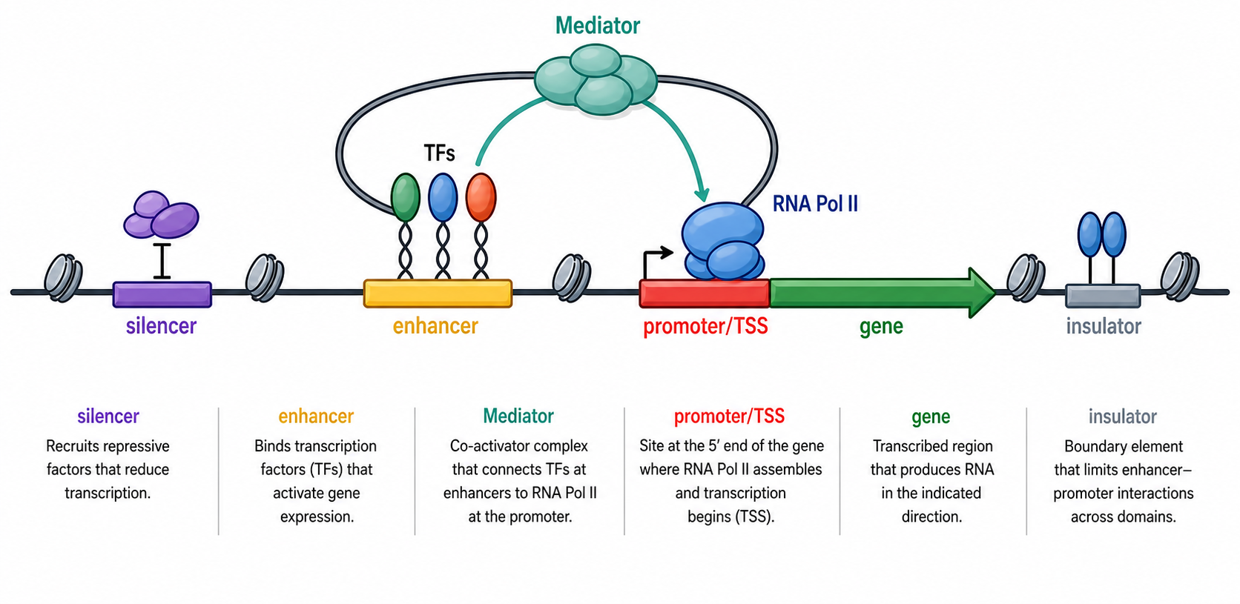
Gene regulation by CREs
CREs are DNA sequences that regulate the transcription of nearby or distal genes on the same chromosome by recruiting transcription factors (TFs), cofactors, and chromatin-associated proteins.
Main clases:
Promoter
Enhancer
Silencer
Insulator
Notes:
Paper Cis-regulatory elements in mammals https://doi.org/10.3390/ijms25010343
A silencer functions similarly to enhancers in that they recruit TFs. It is possible for a regulatory element to silence in one cellular context and enhance in another
CTCF binding sites can function as insulators, but don’t represent all insulators!!

Slide 5
Gene regulation by CREs
Key features of CREs:
Often located in non-coding regions of the genome.
Their activity is highly cell-type, tissue, and developmental-stage specific.
To be active, the DNA usually needs to be accessible to regulatory proteins.
Promoters, enhancers, and silencers are often associated with characteristic chromatin features, including histone modifications.
Insulators are mainly defined by the presence of architectural proteins such as CTCF and cohesin.

Slide 6
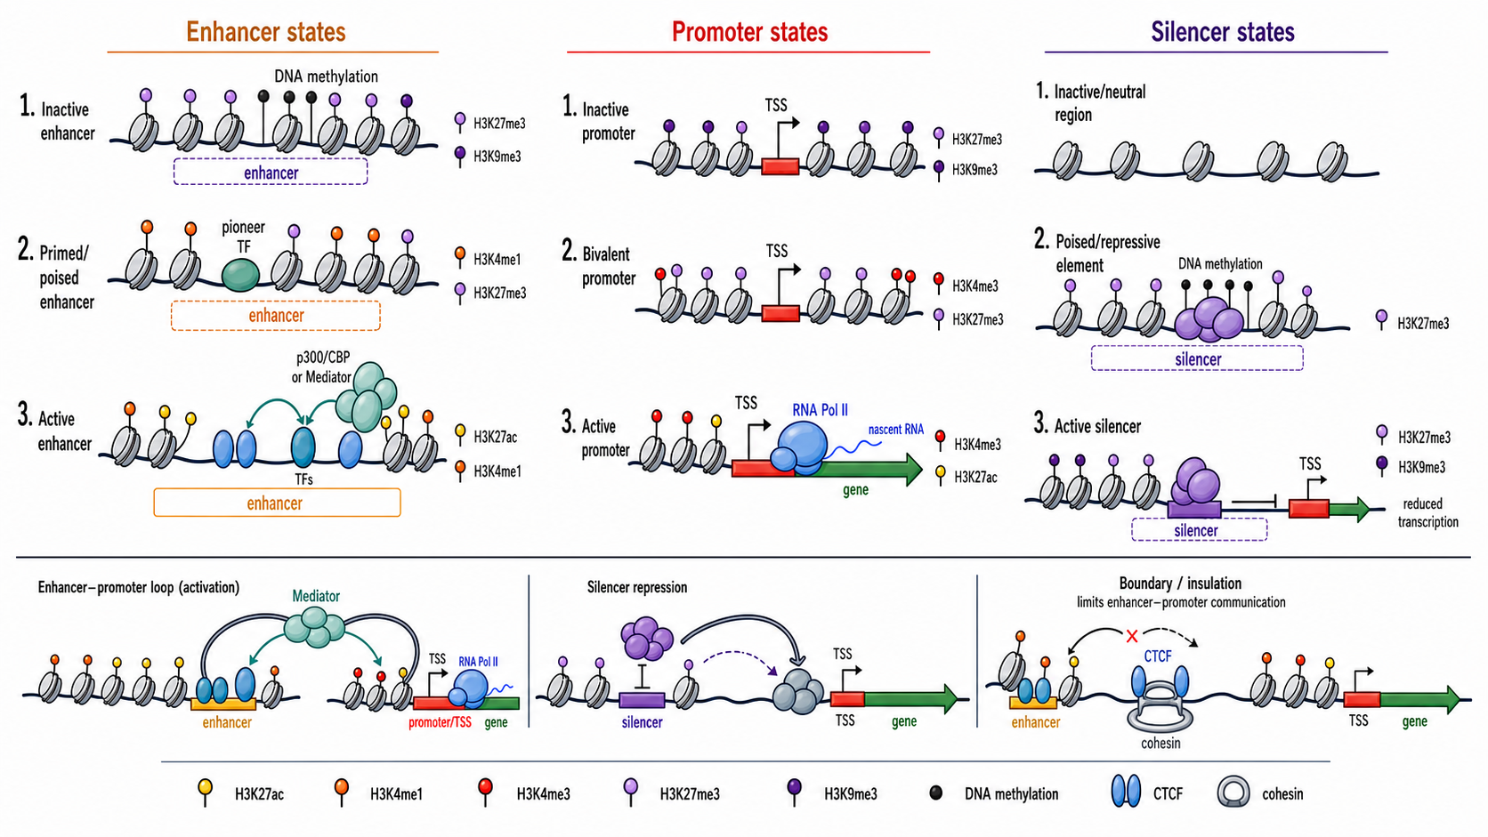
Epigenetic modifications and CREs

Slide 7
A regulatory annotation is a claim built from evidence
Aimed to identify potential regulatory regions in the genome.
Usually built by integrating multiple evidence layers: chromatin accessibility, histone modifications, transcription factor binding, and gene annotation.
Based on specific patterns characterising the different CREs types.
Limited to the availability of useful experimental data.
Limited to the availability of cell-type, tissue, developmental-stage specific experiments.

Slide 8
Evidence useful for defining regulatory annotation
Approach | What it tells you | Advantages | Limitations
Chromatin accessibility | Identifies open DNA where regulatory proteins can bind | Fast genome-wide discovery of candidate CREs; useful first-pass assay | Does not distinguish enhancer, promoter, silencer or insulator by itself
Histone modifications | Profiles chromatin states associated with regulatory activity | Helps classify CRE types and activity states | Correlative; depends strongly on selected marks and cell type
TF and cofactor binding | Shows where regulatory or architectural proteins bind | Links CREs to regulatory proteins such as TFs, p300/CBP, CTCF or cohesin | Binding does not always imply functional regulation
Transcription-based evidence | Detects initiation or nascent transcription from promoters and enhancers | Provides evidence of active regulatory transcription | Weak or unstable enhancer RNAs can be missed
Comparative genomics | Finds conserved non-coding regions under evolutionary constraint | Highlights candidate functional elements across species | Misses lineage-specific or rapidly evolving CREs
Functional assays | Tests whether a sequence can regulate transcription | Provides direct activity evidence for tested sequences | Often outside native chromatin and genomic context
CRE annotation usually combines indirect genome-wide evidence from different sources; no single method is sufficient on its own.

Slide 9
From experimental data to regulatory annotation
Method | Approach | What it detects | Common use | Main limitation
ATAC-seq | Chromatin accessibility | Accessible chromatin | Candidate promoters, enhancers and other open CREs | Open chromatin alone does not define function
DNase-seq |  | DNase-hypersensitive accessible regions | High-confidence accessible regulatory regions | Requires more input and processing than ATAC-seq
ChIP-seq | Histone modifications / TF binding | Histone marks or protein-DNA binding | Profiles marks such as H3K27ac, H3K4me1, H3K4me3 or TF binding | Resolution and quality depend on antibody and sequencing depth
CUT&RUN |  | Targeted protein-DNA interactions | Lower-input profiling of histone marks or TF binding | Requires optimized antibodies and protocols
CUT&Tag |  | Targeted chromatin-associated proteins | Efficient profiling of histone marks and TFs | Can be sensitive to protocol and background differences
Notes:
Useful pre-course material:
https://www.youtube.com/watch?v=nkWGmaYRues
Paper Cis-regulatory elements in mammals https://doi.org/10.3390/ijms25010343

Slide 10
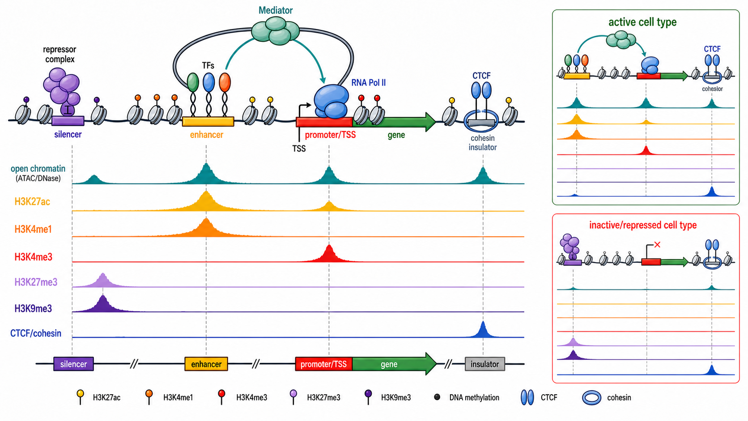
From experimental data to regulatory annotation

Slide 11
From experimental data to regulatory annotation
Method | Approach | What it detects | Common use | Main limitation
CAGE-seq | Transcription-based evidence | Transcription start sites | Identifies active promoters and enhancer transcription | Depends on detectable capped transcripts
GRO-seq / PRO-seq |  | Nascent transcription | Detects active transcription at genes and enhancers | More specialized assays and analysis
Sequence conservation | Comparative genomics | Evolutionary conserved non-coding regions | Candidate conserved CREs | Misses species-specific regulatory elements
MPRA | Functional assays | Activity of many tested sequences in parallel | High-throughput enhancer or variant testing | Removed from native genomic context
STARR-seq |  | Enhancer activity of cloned fragments | Genome-scale enhancer activity screening | Activity depends on assay design and cell system
CRISPRi / CRISPRa |  | Effect of repressing or activating candidate CREs | Links regulatory elements to target genes or phenotypes in their genomic context | Requires guide design, suitable cell model, and careful interpretation of off-target or indirect effects

Slide 12
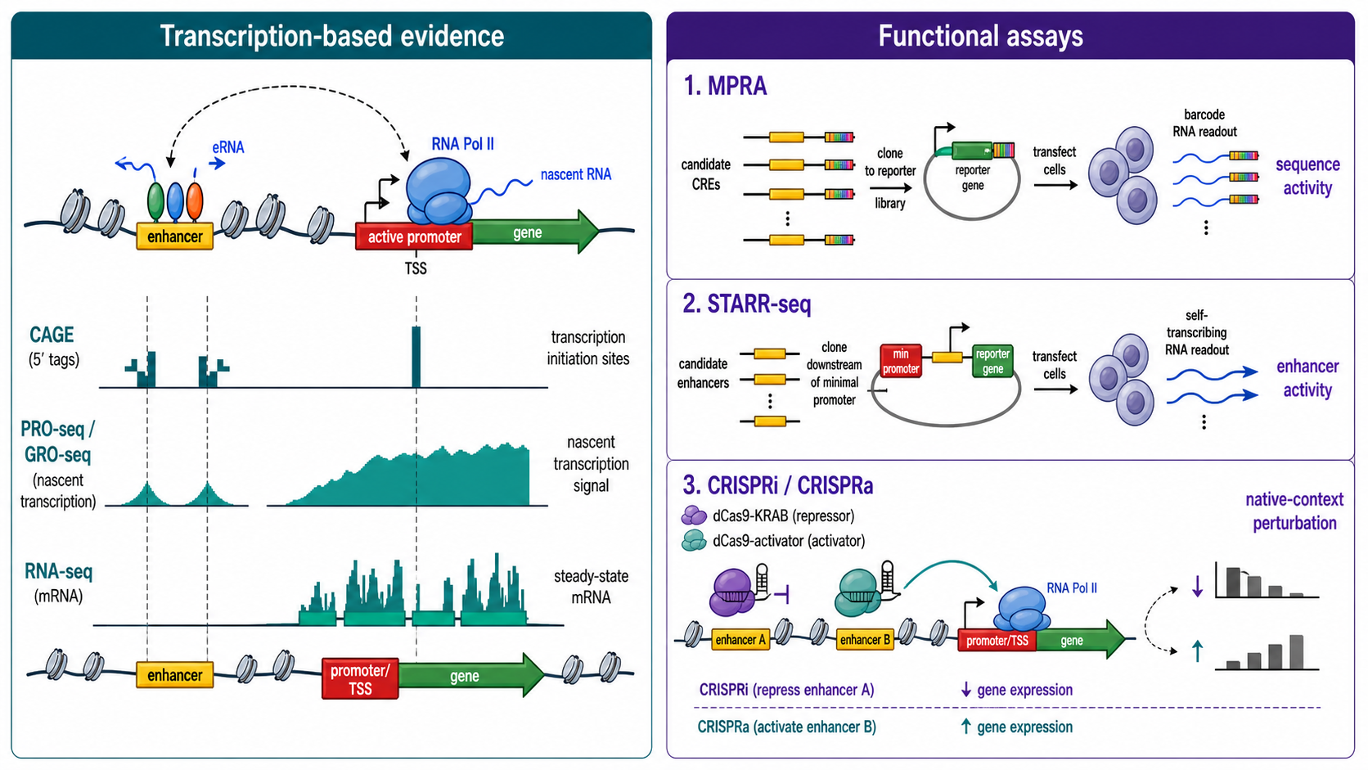
From experimental data to regulatory annotation

Slide 13


Epigenomic evidence: Large-scale community efforts
Community consortia that generate standardized epigenomic datasets.
They cover multiple tissues, cell types, and species.
Aimed to contribute to the understanding of genome function.
Focused on human and mouse
Data types: chromatin accessibility, histone marks, TF binding, DNA methylation, RNA expression, 3D genome assays.
Outputs: peaks, genome annotations, candidate CREs.
Focused on animal genomes, especially farmed animals.
Data types: coordinated epigenomic and transcriptomic assays across tissues and species.
Outputs: standardized datasets, metadata, genome annotations.

Slide 14
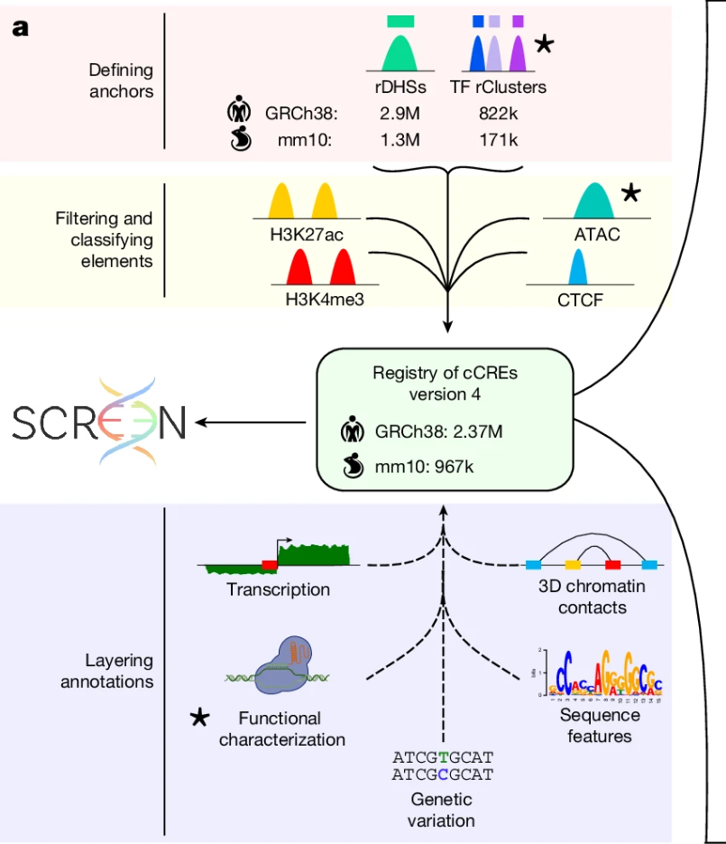

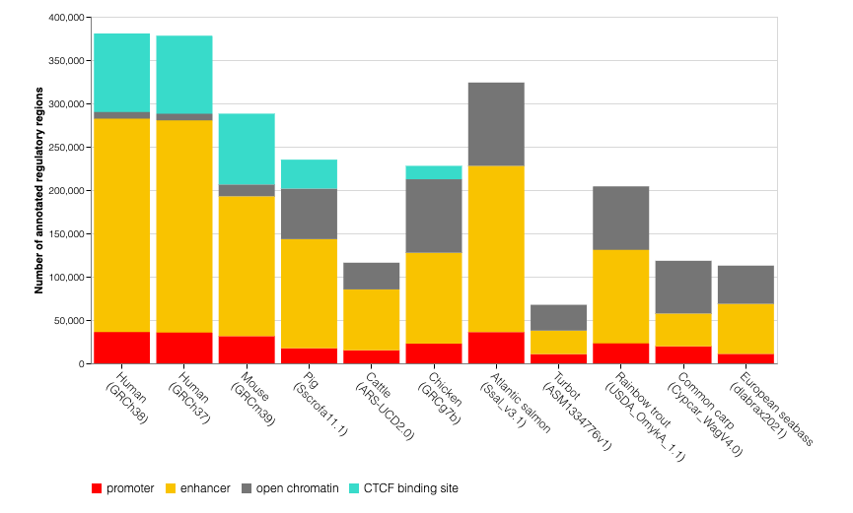
Strategies for genome-wide detection of CREs
Mainly based on strategies combining open chromatin and histone/TF ChIP-seq experiments from large-scale efforts involving several species.
Focused on detecting:
Promoter-like sequences
Enhancer-like sequences
Open chromatin regions
Transcription factor
binding regions
https://www.nature.com/articles/s41586-025-09909-9

Slide 15
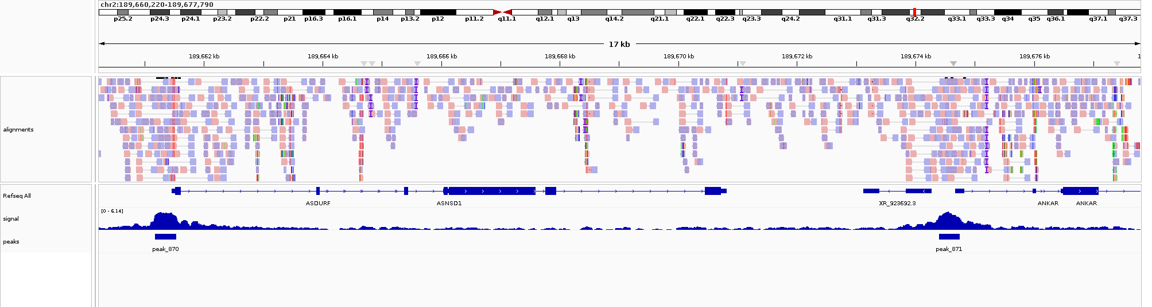
Strategies for genome-wide detection of CREs
Require genome-wide experimental assays in several cell lines, tissues and developmental-stages
Each assay will usually produce two tracks:
Signal: Quantitative coverage or enrichment signal
Peaks: Genomic intervals identified through statistical analysis of signal tracks

Slide 16
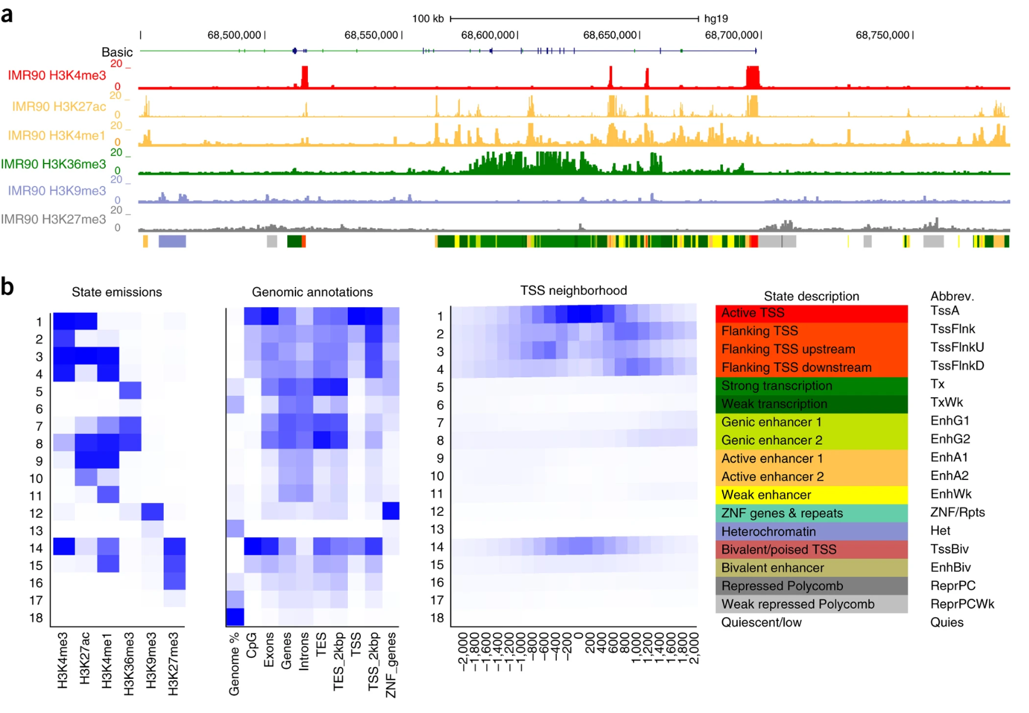
Strategies for genome-wide detection of CREs
Genome segmentation by unsupervised machine learning methods
Strengths:
Integrates several histone marks/accessibility tracks into one compact genome-wide annotation.
Learns recurrent mark combinations de novo.
Produces interpretable state definitions: e.g. H3K4me3 + H3K27ac-rich states suggest active promoters; H3K4me1 + H3K27ac suggests enhancers.
Gives every genomic bin a label, making the non-coding genome easier to visualise and compare across cell types.
Widely used and scalable.
Figure extracted from Chromatin-state discovery and genome annotation with ChromHMM¹.
¹Ernst, J., Kellis, M. Chromatin-state discovery and genome annotation with ChromHMM. Nat Protoc 12, 2478–2492 (2017). https://doi.org/10.1038/nprot.2017.124

Slide 17
Strategies for genome-wide detection of CREs
Genome segmentation by unsupervised machine learning methods
Limitations:
State names are interpretations, not guarantees: an “enhancer” state is a candidate enhancer annotation, not proof that every bin with this state functions as an enhancer.
The number of states is chosen by the user; too few states can merge biology, too many can create hard-to-interpret subclasses.
Resolution is limited by bin size and assay resolution.
Results depend strongly on input marks, data quality, binarisation, and missing assays.
Figure extracted from Chromatin-state discovery and genome annotation with ChromHMM¹.
¹Ernst, J., Kellis, M. Chromatin-state discovery and genome annotation with ChromHMM. Nat Protoc 12, 2478–2492 (2017). https://doi.org/10.1038/nprot.2017.124

Slide 18
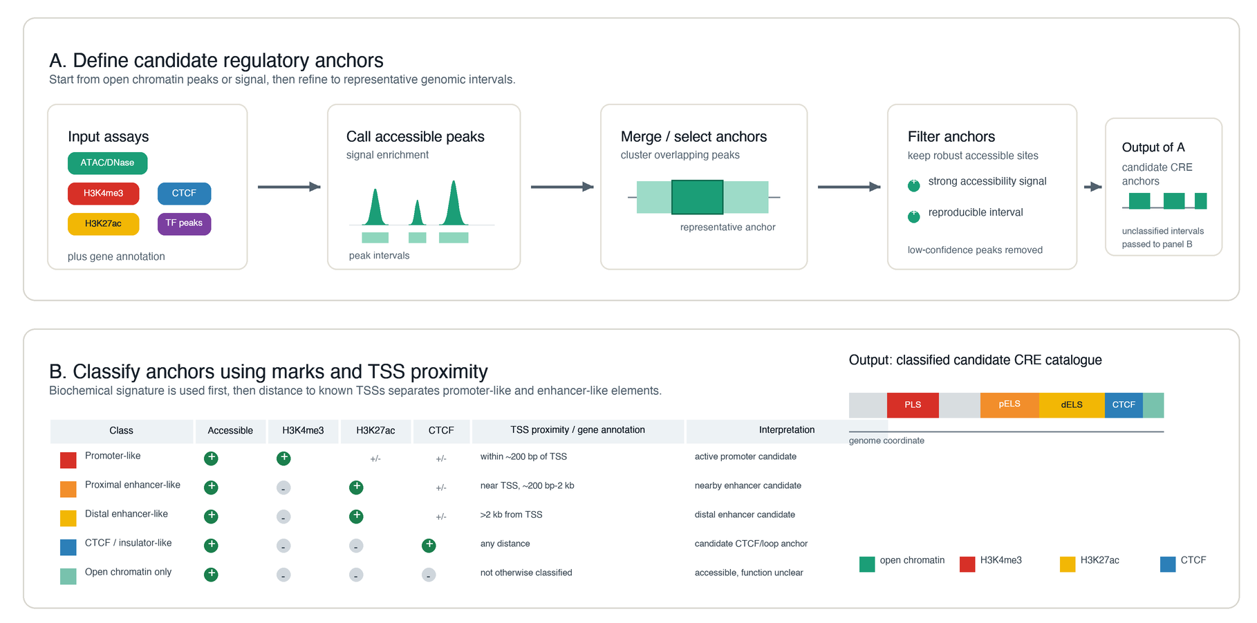
Strategies for genome-wide detection of CREs
Open chromatin-guided annotation of CREs
Strengths:
Directly uses chromatin accessibility, a strong hallmark of active or poised regulatory DNA.
Produces focal candidate regions, often easier to intersect with variants than broad chromatin states.
More transparent than unsupervised segmentation: rules like H3K4me3 near TSS = promoter-like, H3K27ac distal = enhancer-like.
Scales well across many tissues/cell types.
Useful for variant interpretation because it gives a practical catalogue of candidate regulatory elements.

Slide 19
Strategies for genome-wide detection of CREs
Open chromatin-guided annotation of CREs
Limitations:
Open chromatin is not proof of regulatory function; it marks candidate, not validated CREs.
Functional labels are heuristic: “enhancer-like” does not guarantee enhancer activity.
Cell type-, tissue-, stage-, or condition-specific elements may be missed if those contexts are not represented in the open chromatin data.
Classification depends on assay availability and quality; missing H3K27ac, H3K4me3, CTCF, or TF-binding data can limit annotation.
Target genes, direction of effect, and causal nucleotides require extra evidence such as eQTLs, CRISPR perturbation, reporter assays, or chromatin contacts.

Slide 20
Questions?

Slide 21
Hands-on

Slide 22

The Integrative Genomics Viewer (IGV)
The Integrative Genomics Viewer (IGV) is a high-performance, easy-to-use, interactive tool for the visual exploration of genomic data. It supports flexible integration of all the common types of genomic data and metadata, investigator-generated or publicly available, loaded from local or cloud sources.
IGV is available in multiple forms, including:
the original IGV - a Java desktop application,
IGV-Web - a web application,
igv.js - a JavaScript component that can be embedded in web pages (for developers)
See https://igv.org for links to all forms of IGV.

Slide 23
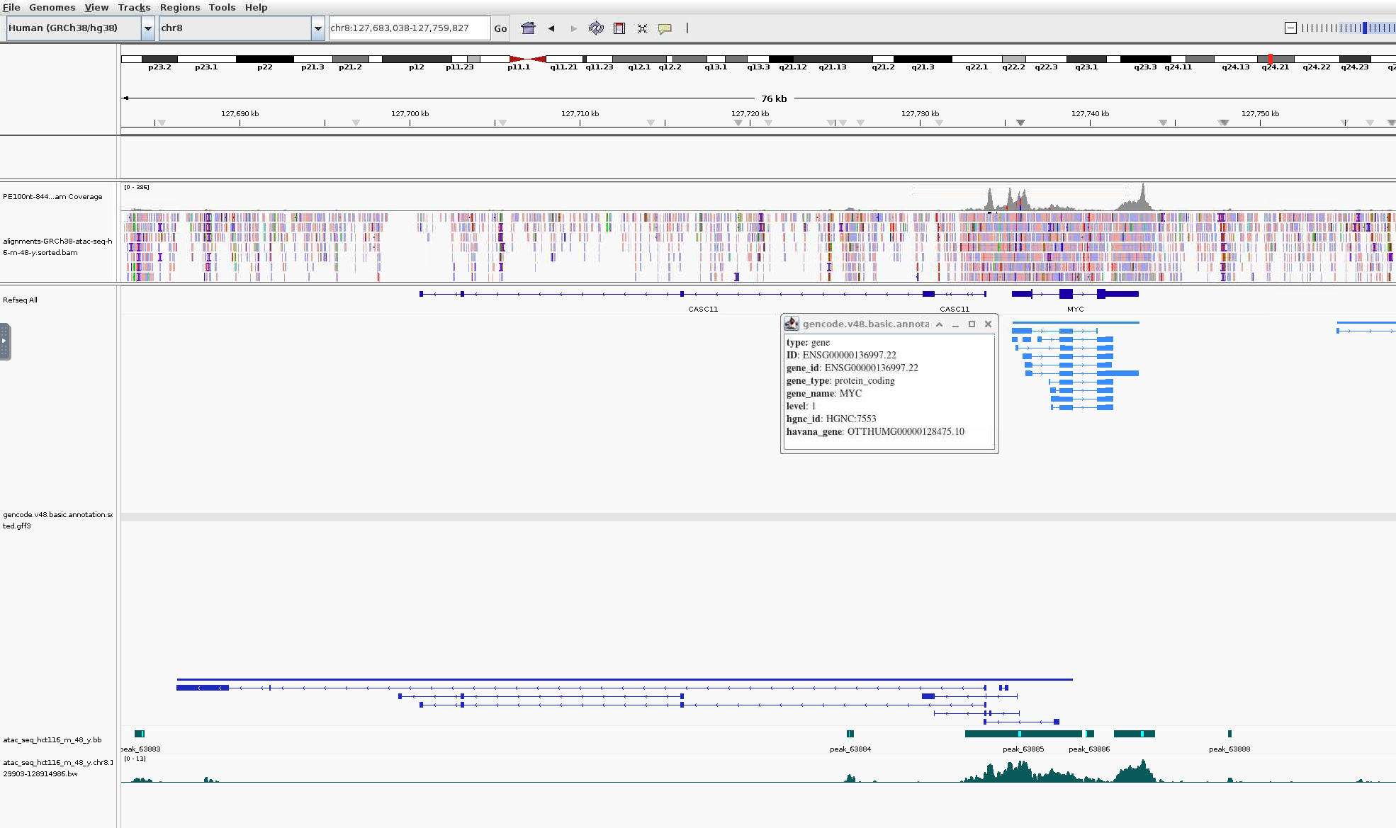
The IGV window
Chromosome
Location
Zoom tool
Genome
Genome ruler
Alignments
Gene annotation
ATAC-seq signal and peaks

Slide 24
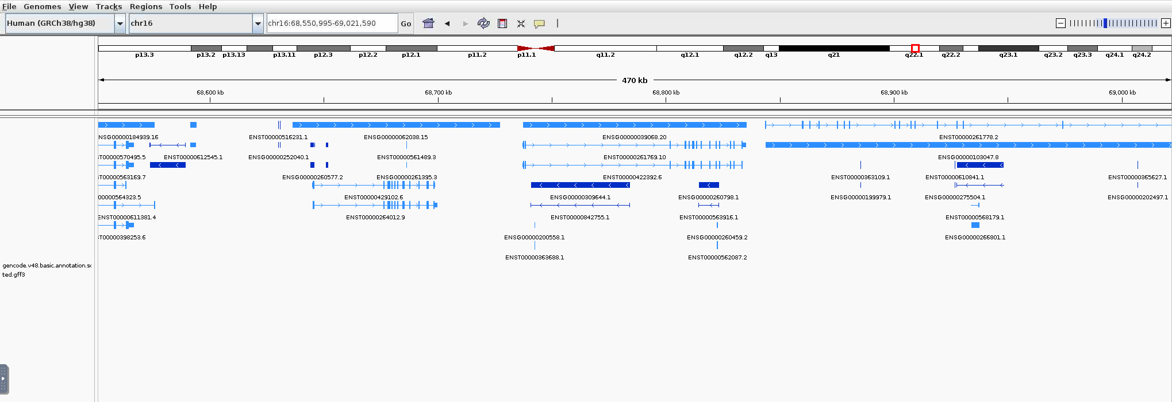
Understanding gene annotation tracks
Genes
Forward strand features
Transcripts
Reverse strand features

Slide 25

Understanding gene annotation tracks
Are these features in the reverse or forward strand?

Slide 26

Do not edit
How to change the design
Are these features in the reverse or forward strand?
Presenting with animations, GIFs or speaker notes? Enable our Chrome extension
Notes:
📣 This is Slido interaction slide, please don't delete it. ✅ Click on 'Present with Slido' and the poll will launch automatically when you get to this slide.

Slide 27
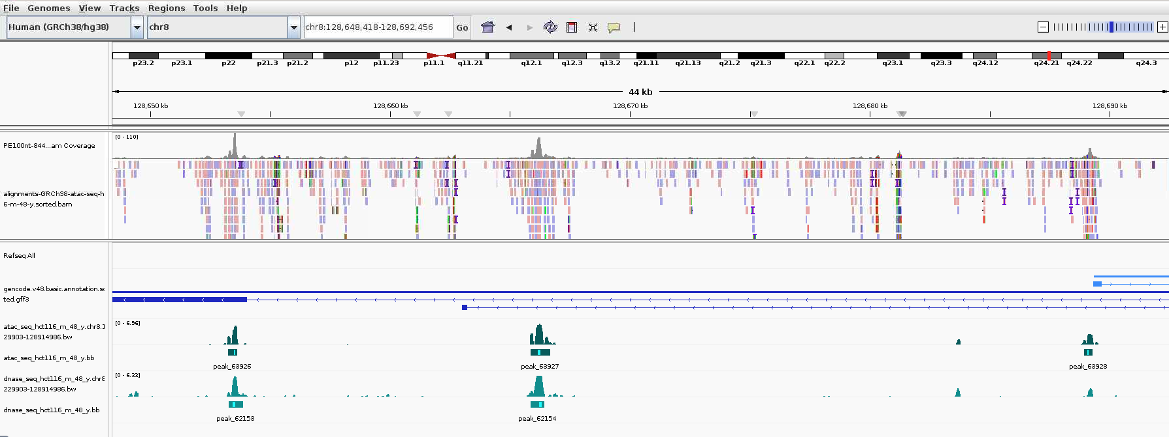
Understanding epigenomics tracks
Is there evidence of open chromatin here?
ATAC-seq
DNase-seq

Slide 28
Do not edit
How to change the design
Is there evidence of open chromatin here?
Presenting with animations, GIFs or speaker notes? Enable our Chrome extension
Notes:
📣 This is Slido interaction slide, please don't delete it. ✅ Click on 'Present with Slido' and the poll will launch automatically when you get to this slide.

Slide 29
Understanding epigenomics tracks
Is there evidence of open chromatin here?
ATAC-seq
DNase-seq

Slide 30
Do not edit
How to change the design
Is there evidence of open chromatin here?
Presenting with animations, GIFs or speaker notes? Enable our Chrome extension
Notes:
📣 This is Slido interaction slide, please don't delete it. ✅ Click on 'Present with Slido' and the poll will launch automatically when you get to this slide.

Slide 31
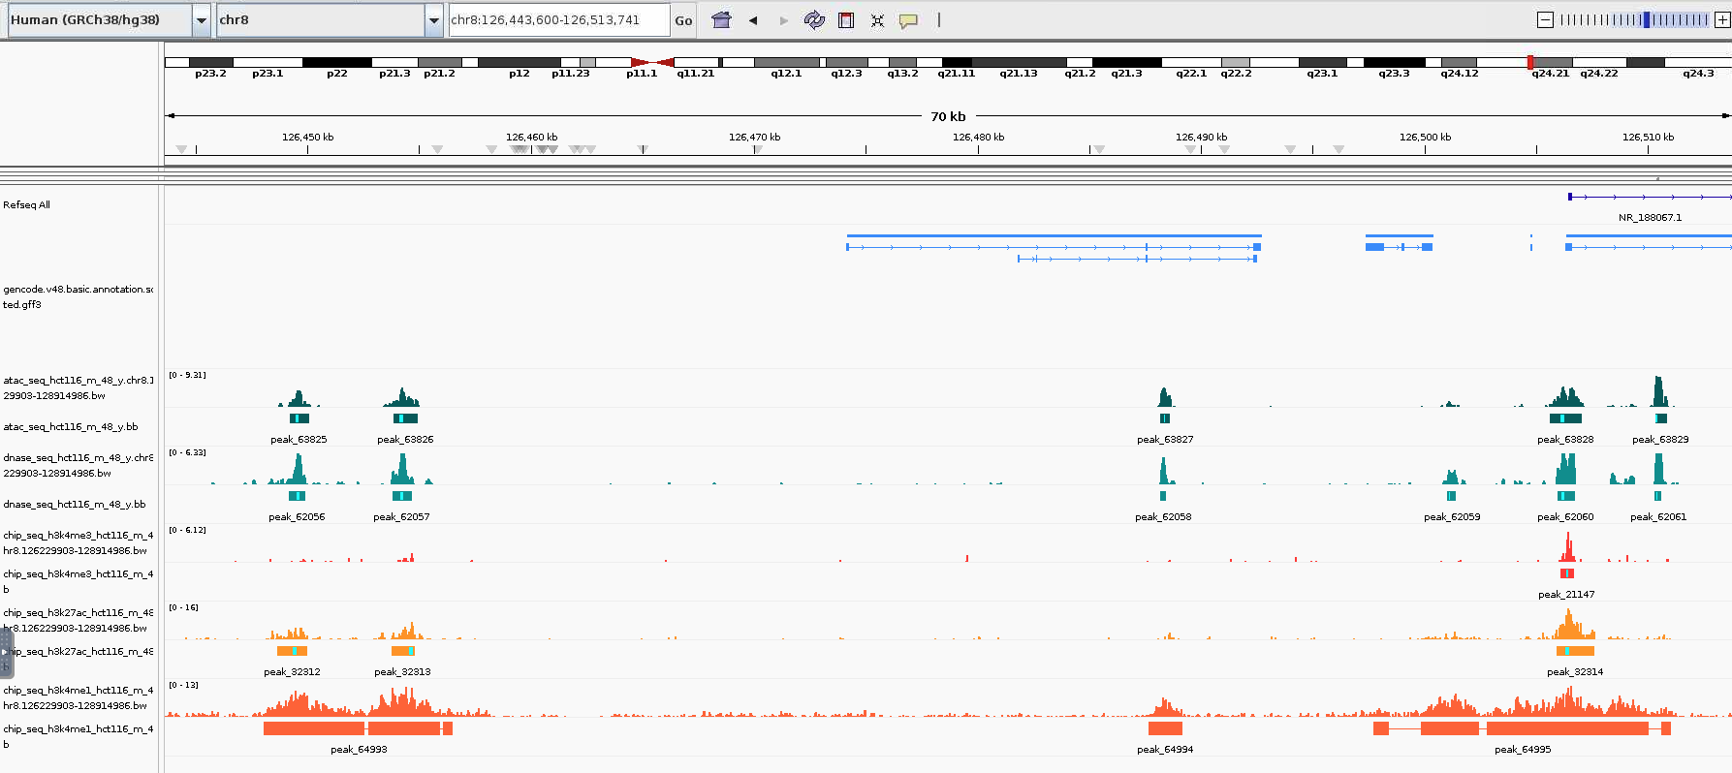
Understanding epigenomics tracks
ATAC-seq tracks
DNase-seq tracks
H3K4me3 tracks
H3K27ac tracks
H3K4me1 tracks

Slide 32
Understanding epigenomics tracks
Which CRE could be annotated here?
ATAC-seq tracks
DNase-seq tracks
H3K4me3 tracks
H3K27ac tracks
H3K4me1 tracks

Slide 33
Do not edit
How to change the design
Which CRE could be annotated here?
Presenting with animations, GIFs or speaker notes? Enable our Chrome extension
Notes:
📣 This is Slido interaction slide, please don't delete it. ✅ Click on 'Present with Slido' and the poll will launch automatically when you get to this slide.

Slide 34
Understanding epigenomics tracks
Which CRE could be annotated here?
ATAC-seq tracks
DNase-seq tracks
H3K4me3 tracks
H3K27ac tracks
H3K4me1 tracks

Slide 35
Do not edit
How to change the design
Which CRE could be annotated here?
Presenting with animations, GIFs or speaker notes? Enable our Chrome extension
Notes:
[CHECK]
📣 This is Slido interaction slide, please don't delete it. ✅ Click on 'Present with Slido' and the poll will launch automatically when you get to this slide.

